Slide 1





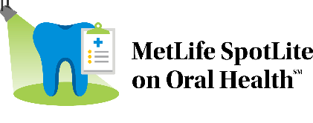
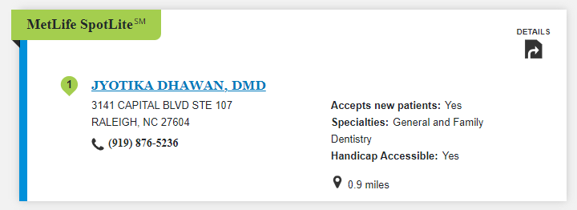

Dental Insurance
Find a Dental Provider
With MetLife Dental insurance, you can choose from thousands of general dentists and specialists nationwide. You can find the names, addresses, languages spoken and phone numbers of participating dentists by searching our online Find a Dentist directory.
Step 1:
Go to metlife.com
Step 2:
Select “Find a Dentist” next to “How can we help you?”
Step 3:
Select “PDP” or
“PDP Plus” next to “Choose your network.”
Enter your Zip, City or State and select the “Find a Dentist” button.
New for 2024
Finding the right dentist is important, MetLife SpotLite on Oral Health^{sm} is a recognition awarded to dentists for a focus on preventive oral care and improved oral health outcomes. Look for the MetLife SpotLite badge when selecting a dentist.
Like most group benefit programs, benefit programs offered by MetLife and its affiliates contain certain exclusions, exceptions, waiting periods, reductions, limitations and terms for keeping them in force. Please contact MetLife or your plan administrator for complete details.
Metropolitan Life Insurance Company | 200 Park Avenue | New York, NY 10166
© 2024 MetLife Services and Solutions, LLC.

