Slide 1
MetLife Resources MFSP Enrollment Process

Slide 2
Background
Effective September 2019, the process for ordering MFSP enrollment materials. The following slides will detail:
The kit components
Ordering process
Changes to the order forms

Slide 3
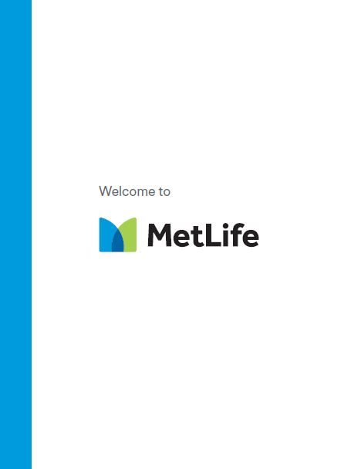
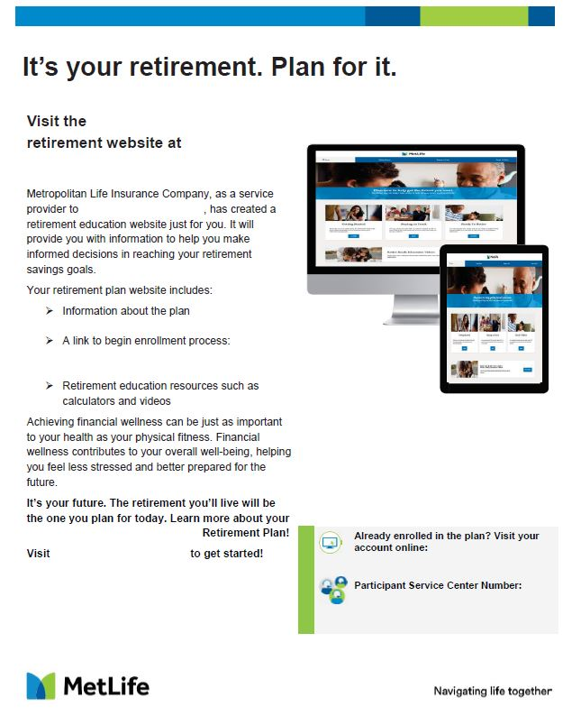
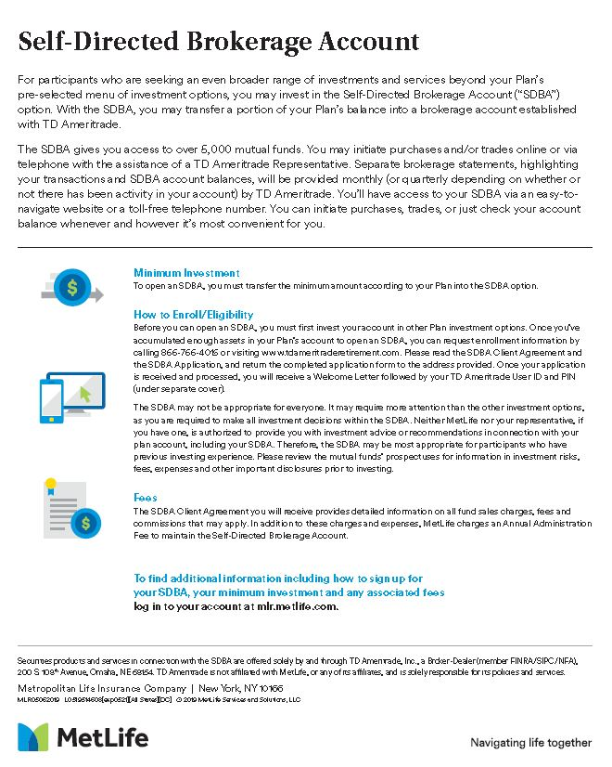
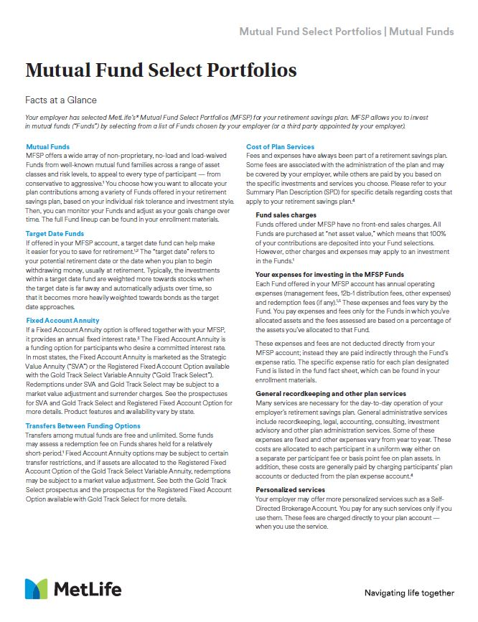
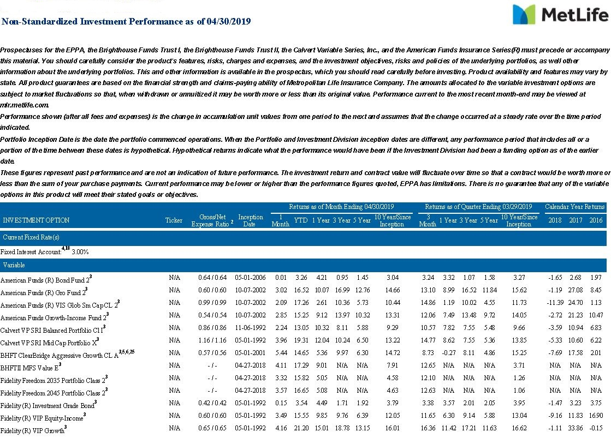
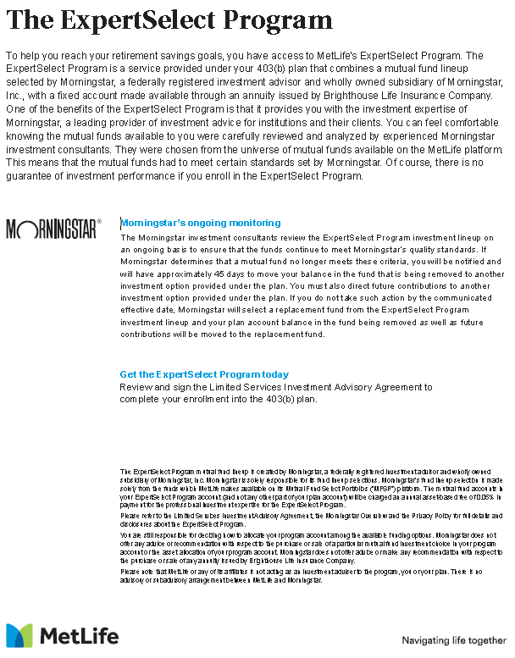
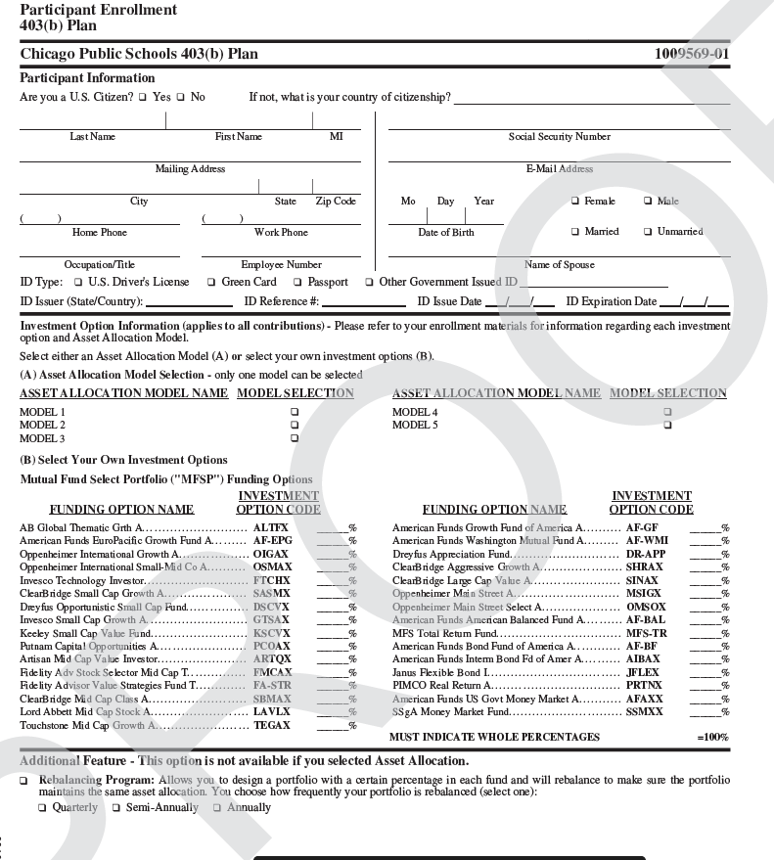
Standard kit components
Plan-At-A-Glance flyer
Required
Optional
Custom Microsite flyer
If applicable
Facts-At-A-Glance flyer
ExpertSelect flyer
If applicable
Triple Solutions flyer
Self-Directed Brokerage Account flyer
If applicable
If applicable
Investment Options -At-A-Glance flyer (IOAG)
Optional
Enrollment forms
Optional
All kits will be assembled inside our newly created enrollment folder
Updated material

Slide 4
Custom book kit components
Custom Enrollment book
Required
Enrollment forms
Optional
Optional
Investment Options-At-A-Glance
All kits will be assembled inside our newly created enrollment folder
Updated material

Slide 5
Ordering process
Complete enrollment
order form
Email completed
enrollment materials
to the mailbox
Obtain sign-off from
Plan Sponsor
The enrollment order forms have been updated and can be found on metlife.com/MLRpro/
Email should include:
Enrollment order forms
IOAG (if desired, you can download this from Empower)
Forms to be filled out by the plan participant (if desired, enrollment application form, beneficiary designation form, paycheck contribution election form)
Employer logo (if desired)
Send email to: mlr_enrollment@metlife.com
For initial orders or orders that have had changes in plan provisions, Plan sponsors will need to sign-off that the enrollment books are correct
This step is new

Slide 6
Changes in enrollment form
Here are the main changes to the enrollment form you should be aware of:
When completing the enrollment form you will need to fill out all relevant information for the type of plan you’re requesting a book for.
To make sure the form is complete hit the ‘check form’ button at the top of the form to ensure the form is complete.
Missing information will be highlighted in red. Please be sure to complete those fields. If those fields are not completed the form will be sent back to the requester to complete.

Slide 7
Investment Options-at-a-Glance flyer
Fund information will no longer be included in the actual flyer. If you’d like fund information included in the kit you must download the IOAG from Empower and include it with your enrollment form when it’s submitted.
Follow these steps to download your IOAG:
1
2
3
4
Log into the Plan Service Center with your ID/Password
Select plan using plan name or plan number
From the Plan menu, select Investments & performance option
The investment performance displays under Investment Options, it’s also available as a pdf if you click the Investment Performance detail link above the returns

Slide 8
How does the sign-off process work?
Sign-off is required when there are changes in plan provisions or initial set ups. Orders made using the new process will be considered new orders and will require sign-off.
You will be sent a flyer for approval and a sign-off form
Plan sponsor must review the flyer and if it’s accurate they must complete the sign-off form
Once the sign-off form is complete, please return it in the original email we sent you
1
2
3

Slide 9
Reorders
If you need new updated fund sheets/enrollment forms:
- There’s no need to submit a new request
- Print out the fund sheets from the Investment Options-At-A-Glance (IOAG) or the enrollment forms from Empower and replace them in the folders you currently have
If you need additional flyers and no details of the plan have changed:
Fill out the ‘Reprint Order’ tab in the Enrollment Kit Order form
You will be sent back the most recently ordered copy of the flyer

Slide 10
Disclosure
MetLife Resources is a division of Metropolitan Life Insurance Company (MLIC) (“MetLife”), 200 Park Avenue, New York, NY 10166. MetLife Investors Distribution Company (MLIDC) (member FINRA) makes available participation in mutual fund options through its Mutual Fund Select Portfolios, for certain retirement plans. You may participate in the Mutual Fund Select Portfolios through your retirement plan. Both MLIC and MLIDC are MetLife companies.
MLR200516-2 L0723033162[exp0725][All States][DC] © 2023 MetLife Services and Solutions, LLC

Slide 11
Thank you.

