Slide 1

MetLife Resources
Providing flexible retirement solutions, backed by industry expertise and customized personal support.
Retirement Education
Enrolling in your employer-sponsored retirement plan
Notes:
Welcome to your employer-sponsored retirement plan, brought to you by MetLife. We hope this presentation gives you an overview of important concepts regarding your employer-sponsored retirement plan. The choices you make today can have a big impact on your family’s financial security.

Slide 2
Why save for retirement?
Food, shelter, healthcare
You may need to replace your current income in retirement
Future standard of living depends on how well you save and invest right now
Notes:
Will your current savings meet your basic needs in retirement—food, shelter, healthcare? Now think about how you actually would like to spend your retirement. What quality of life do you envision?
The standard of living that you will enjoy depends—in part—on how you save and invest right now. Keep those dreams in mind as you put money aside, a little at a time. Whether you hope to spend your time travelling, relaxing with family, or exploring new hobbies, these goals will help keep you motivated as you continue to save for your retirement goals.
And if you’re viewing this, your employer provides one of the best ways to save for your future. Get started today!

Slide 3

What are potential sources of retirement income?
Social Security
Pensions
Personal Savings
Annuities
Individual Retirement Savings (IRAs)
3
Notes:
Let’s take a look at some of the potential sources of retirement income:
Social Security
The amount of income supplied by Social Security will depend on several factors, like earnings history and when you begin receiving benefits.
Personal Savings
A savings account is one of the simplest and most common bank accounts. It allows you to store your cash securely and earn interest on your money. They provide quick and easy acces,s, but may provide a low rate of return.
Individual Retirement Accounts (IRAs)
An IRA is an account used to place retirement savings for potential greater return than a traditional savings account. IRAs can consist of a range of financial products such as stocks, bonds, or mutual funds.
Pensions
With pension plans—which are becoming less common—employers contribute money to the plan while you are working. The money will be paid to you—usually as a monthly check in retirement—after you reach a specific retirement age.
Annuities
Annuities are a tax-deferred contract issued by an insurance company that can provide income for a specified time period—such as a number of years or for life.
These sources may not be enough. Your employer-sponsored retirement plan is a great way to help bridge the gap.

Slide 4

Understanding your retirement plan:
Employer-established, generally funded with your before-tax contributions
You choose how to allocate your money
Your employer determines plan features, and in some cases, makes contributions
Receive tax benefits while your money grows
Add footnote here.
4
Notes:
403(b), 457, and 401(k) may not be very descriptive names, but these plans offer strong incentives to save for retirement. Named after a section of the federal tax code—these plans are employer-established and generally funded with your before-tax salary contributions.
And, whether it’s a 403(b), 457, or 401(k), the concepts are similar. You choose how to allocate your money with the vehicles included in your plan, and you control how much to invest in each of the plan’s investment options. Contributions and any growth in your account are tax-deferred until you withdraw the money. Once money is in your account, you generally cannot make withdrawals before age 59½ —except for special circumstances.
Your employer, as the Plan Sponsor, determines plan features, participant investment choices, and — in some cases — makes contributions. Plan Sponsors typically select the funding vehicles where participants allocate their contributions and outsource certain administrative and recordkeeping functions to one or more third parties.
Whether it’s a fixed annuity, variable annuity, or a mutual fund platform, salary deferral plans give you a degree of control over your money. And by participating in a plan, you receive tax benefits while giving your money the opportunity to grow.

Slide 5
What are the advantages of joining?
It’s easy
It’s there in an emergency
It reduces your current taxes
MetLife makes access to your account convenient
It grows tax-deferred
It’s never too early
It’s never too late
*Certain employees participating in 403(b) plans of school, health care or church employers may be eligible to make additional catch-up contributions based on years of service, rather than age. Certain government employees participating in 457(b) plans may be able to make additional contributions instead of normal catch-up contributions during the three years prior to normal retirement age.
If you are buying a variable annuity to fund a qualified retirement plan or IRA, you should do so for the variable annuity’s features and benefits other than tax deferral. In such cases, tax deferral is not an additional benefit of the variable annuity. References throughout this material to tax advantages, such as tax deferral and tax-free transfers, are subject to this consideration.
It’s your choice
It may be matched by your employer
5
Notes:
Here are just a few of the many reasons to start contributing to your plan.
It’s Easy—Your contributions are deducted from your pay and deposited directly into your account—this way you aren’t tempted to spend the money.
It Reduces Your Current Taxes—Your contributions are made to your account before taxes are taken out. That means you have the opportunity to put more money towards retirement.
It Grows Tax-Deferred—Pre-tax contributions and earnings are not subject to taxes until funds are withdrawn. Then they are treated as ordinary income. Taxes don’t go away with retirement and may even be your most expensive obligation. State income taxes may also apply. Always consult your tax advisor or investment professional about the income tax consequences of any withdrawals.
It’s Never Too Early—The younger you are, the longer you can take advantage of the power of tax-deferred compounding of your contributions. Compounding is simply the concept of earning on your contributions and earnings.
It’s Never Too Late—Even if you didn’t start early, don’t despair. If you’re over age 50, you may be eligible to make special catch-up contributions. If permitted by your plan, these catch-up contributions let employees save more pre-tax money for retirement, beyond the normal maximum contribution limits.
It’s Your Choice—You decide how much—and where—you want to contribute based on the investment options available in your plan, subject to plan limits and the Internal Revenue Code (IRC) maximum contribution limits. Review your options to avoid contributing over the maximum allowable limit and having to pay an additional penalty tax on the excess contributions.
It May be Matched by Your Employer—Some employers make contributions based on employee deferrals—referred to as matching contributions. If your Employer makes matching contributions, make sure you’re contributing enough to receive the full employer match or you may be leaving money on the table.
It’s There in an Emergency—Loan, hardship, or unforeseeable emergency withdrawal provisions differ among plans. The provisions that apply to you are based on your specific plan.
MetLife Makes Access to Your Account Convenient—You have the ability to keep track of your account by either managing your account online via your plan’s website or calling the toll-free phone number and speaking with a Customer Service Representative.
Contact your employer to learn the features of your plan.

Slide 6
What are the basics of retirement investing?
Saving puts money aside for short-term needs
Investing puts money aside for long-term needs
Notes:
What’s the difference between saving and investing? Saving puts money aside in a safe place for short-term needs—like a bank account or a money market. Investing puts money aside for long-term growth in an effort to realize potential higher returns.
• Not a Deposit • Not FDIC-Insured • Not Insured By Any Federal Government Agency • Not Guaranteed By Any Bank Or Credit Union • May Go Down In Value

Slide 7

When’s the best time for me to start saving?
Right now
Pay yourself first
Waiting means larger contributions later
7
Notes:
So, when’s the best time for me to start saving? Now!
Everyone has heard the phrase “Pay yourself first,” and when it comes to saving and investing for retirement, time is your best friend. The power of compounding can be impressive, but it takes time for it to do its work. If you wait, you may miss a great opportunity and have to make much larger annual contributions later to help reach your retirement savings goal. Don’t procrastinate!
And it’s never too late to start; tiny steps can make a big difference. Every dollar helps in the long run.

Slide 8
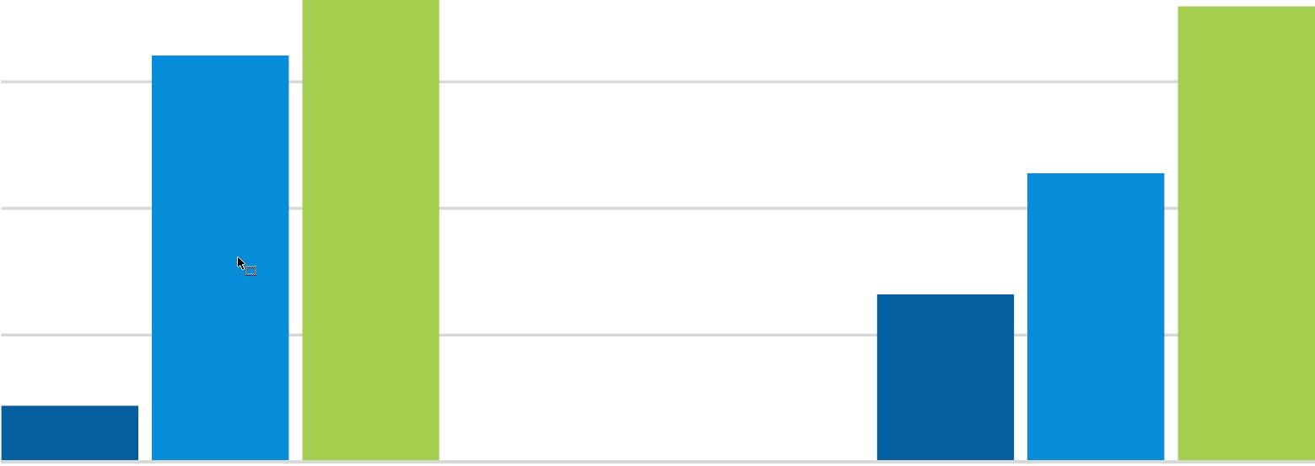

Hypothetical Example: Not everyone saves the same, but there are things we should all consider
Starting Early
Starting Later
Assuming both earned a 6% annual rate of return, Mary’s early start puts compound earnings to work for her sooner.*
Mary
Start Age 25 – End Age 35
Annual Contribution $2,000
Total Contribution $22,000
Bill
Start Age 35 – End Age 65
Annual Contribution $2,000
Total Contribution $62,000
Account Balance $182,298
Account Balance $179,780
Consider how much to save!
*Please note that federal tax laws limit contributions. The amount you may contribute annually may differ from that shown. The 6% rate is an assumed rate for illustrative purposes only and returns are not adjusted for inflation or taxes. No reference to any specific MetLife product is intended. Investment returns will vary and there is no guarantee that any individual who makes such contributions will reach these values. This does not reference a Roth plan.
Notes:
Let's compare two investors in this Hypothetical Example:
CLICK Mary gets an early start. At 25, she starts investing $2,000 a year in her plan, and then invests nothing after age 35. By age 65, the total amount she has contributed to her account is $22,000.
CLICK Bill starts later. He waits until he's 35 to invest the same $2,000 a year and contributes every year through age 65. By 65, the total amount he has contributed to his account is $62,000.
CLICK Assuming both Mary and Bill earned a 6% annual rate of return, CLICK by age 65, Mary’s account will have accumulated $182,298 and Bill’s $179,780. Mary's nest egg will be over $2,500 dollars more than Bill's.⁴
Bill has contributed more than Mary, but due to compounding, he will have less in retirement savings. Mary’s early start put compound earnings to work for her sooner.
You may ask “How much should I be saving?”
Consider the following answers:
1) as much as you comfortably can, and
2) something is better that nothing.
But how will you replace a portion of your annual pre-retirement income throughout retirement?
It’s important to know your current financial situation.

Slide 9
Understanding your financial situation
Empower
How much will I need in retirement?
Day-to-day expenses may decrease, but insurance and healthcare may increase.
What is dollar cost averaging?
The process of investing a set amount at regular intervals over a long period of time.
How does vesting work?
Anything you contribute is always 100% vested. Employer contributions (if applicable), may be subject to a vesting schedule.
Find retirement resources at metlife.com/retireready
MetLife delivers real-time text and email security alerts to users when any of
the following events are initiated via the participant website or the call center
*Dollar cost averaging does not ensure a profit, nor does it protect against a loss in declining markets. It involves continuous investment in securities regardless of fluctuating price levels. You should consider your ability to continue purchases in periods of low or fluctuating price levels.
9
Notes:
How much will I need in retirement?
While your day-to-day expenses may be lower in retirement, there are several that are likely to increase, such as insurance, healthcare, and prescription medicine. Extending your working life just a few more years may enable you to achieve your goals and retire comfortably. A retirement savings calculator can help give you an idea about how to reach your savings goal. These calculators are readily available on metlife.com/retireready as well as most retirement planning websites.
What is Dollar Cost Averaging?
Employee-sponsored retirement plans benefit from Dollar Cost Averaging. Dollar Cost Averaging is the process of investing a set amount of money at regular intervals over a long period of time — regardless of the share price. This approach can potentially reduce the risk of investing a large amount in a single investment when the cost per share is inflated. Basically, you purchase more shares when prices are low and fewer shares when prices are high. Dollar cost averaging does not ensure a profit nor does it protect against a loss in declining markets. It involves continuous investment in securities regardless of fluctuating price levels. You should consider your ability to continue purchases in periods of low or fluctuating price levels.
How does vesting work?
Anything you contribute—including rollover contributions and any earnings on that money—is always 100 percent vested.
Your employer’s contributions may be subject to a vesting schedule—meaning you will vest in a certain percentage of your account each year of employment. Check with your employer for the specific vesting schedule for your plan.

Slide 10


What should I consider when allocating my contributions?
Empower
After you've decided how much to contribute, you need to choose where those dollars will be invested. Diversification and asset allocation is key.*
Stock funds
Bond funds
Cash equivalents
  Your risk tolerance depends on your comfort level.
*While diversification through an asset allocation strategy is a useful technique that can help to manage overall risk and volatility, there is no certainty or assurance that a diversified portfolio will enhance overall return or outperform one that is not diversified. Neither guarantees a profit nor prevents the possibility of loss.
10
Notes:
What is Diversification & Asset Allocation?
After you've decided how much to contribute, you need to choose where those dollars will be invested. Investors typically diversify by allocating certain percentages of their accounts to one or more of the three major asset classes: stocks, bonds, and cash equivalents. Each asset class has its own risk and return characteristics.
Stock funds—Have historically over periods of time offered the most growth potential—but also the most volatility.
Bond funds—May provide some growth and income, though typically not as much as stocks.
Cash equivalents—Offer the most stability, but typically generate little to no growth.
Asset allocation is a simple strategy. By spreading your money among various types of investments, you take advantage of their respective strengths without exposing all of your account to an investment in one concentrated area.
Your risk tolerance depends on your comfort level with ups and downs in the value of your investments, proximity to retirement, and your willingness to accept greater risk.

Slide 11

Choosing the right investment path:
Empower
Mutual Fund Select Portfolios (MFSP)
Open architecture mutual fund platform¹
Competitive fixed account option²
Institutional class funds available
No proprietary mutual funds offered
No-load or load-waived funds
Full disclosure of compensation paid by mutual funds
to MetLife or our affiliates
MetLife and/or its family of companies receive fees from the fund families or their affiliates for administrative, distribution and recordkeeping services.
This is a registered contract that offers a fixed return guaranteed by the insurance company (subject to certain limitations).
11
Notes:
You may already know about mutual funds because they are one of the most popular investment vehicles. Mutual funds pool money from many different individual investors then invest in a variety of securities depending on the mutual fund’s objectives. It’s important to understand the characteristics and objectives of each fund type, so you can maintain a balanced portfolio.

Slide 12


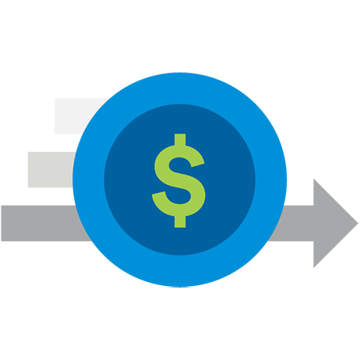
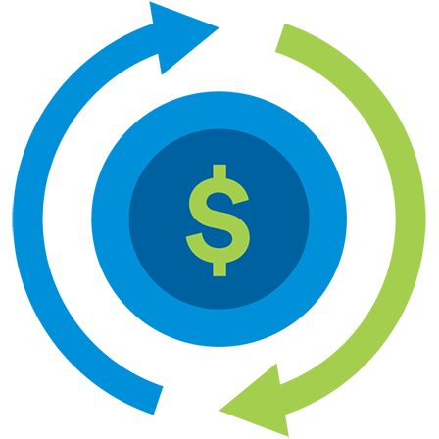

Choosing the right investment path:
Target Date Funds (TDF)
Additional options to enhance your plan
A fund of funds with
an asset mix that adjusts
its portfolio according to
the presumed retirement date of the investor
Each TDF invests in a
set of underlying mutual funds of different asset classes and styles
Because of the
fund-of-funds structure, TDFs have two levels
of fees and charges¹
Automatic
rebalancing
May satisfy as a
Qualified Default Investment Alternative (QDIA)²
*If permitted under the terms of your plan and subject to certain tax rules.
Please refer to submitted RFP response for additional information concerning fund fees.
The QDIA rules do not apply to plans sponsored by government employers and plans not subject to the Employee Retirement Income Security Act of 1974 (ERISA); however, similar State law rules may apply
12
Notes:
A target date fund invests in a set of underlying mutual funds with different investment styles which invest in different asset classes, such as stocks, bonds and cash. The "target date" refers to a potential retirement date or the date when you plan to begin withdrawing money. Typically, the investments within a target date fund are weighted more towards stocks, also known as equities, when the target date is far away and adjusts over time, so that it becomes more heavily weighted towards bonds as the target date approaches.

Slide 13

Investment Line-Up Review
MetLife Financial Freedom Select (MFFS)
MetLife Financial Freedom Select (MFFS) is a variable annuity designed to provide a retirement savings vehicle
for employees of public schools, colleges and universities, not-for-profit hospitals and not-for-profit organizations. MFFS variable annuity provides participants with the opportunity to accumulate assets for retirement as well as provide a steady stream of income throughout their retirement years. Click here for the MFFS state variations grid.
The option and features of this variable annuity include a variety of funding options, including:
Asset Allocation Portfolios, Index Portfolios, Portfolios that invest in Exchange Traded Funds (ETF)
and a Fixed Interest Account.
Automated Investment Strategies such as Equity Generator, Rebalancer, Index Selector and Allocator SM
A 3% Rollover Distribution and Direct Transfer Credit
(Note: MFFS L class is the only available share class offered in the state of NY. The L class offers a 2% credit.)
Free Transfers Among Funding Options
Systematic Withdrawal Program
Death Benefit and an Optional Step-up Death Benefit
Benefit Sensitivity (waivers on withdrawal charges in certain situations/event occurrences)
Refer to the product prospectus for additional information
L Class is the only available share class for new enrollments in the state of New York.
The C Class is only available to new participants in group plans established prior to 4/30/12 with the C Class in the 403(b) ERISA, 457(b) or 401 markets.
13

Slide 14
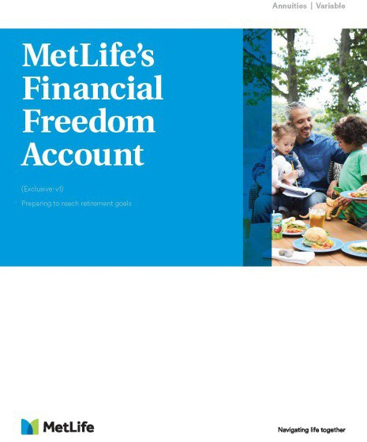
Investment Line-Up Review
The Financial Freedom Account (FFA)
The Financial Freedom Account (FFA) is a variable annuity designed to provide a retirement savings vehicle for employees of public schools, colleges and universities, not-for-profit
hospitals and nonprofit organizations.
The options and features of this variable annuity include a variety of funding options, including:
Asset Allocation Portfolios, Index Portfolios, Portfolios that invest in Exchange Traded Funds (ETF)
and a Fixed Interest Account
An Automated Investment Strategy – Equity Generator
Free Transfers Among Funding Options
Systematic Withdrawal Program
Death Benefit
Refer to the product prospectus for additional information
This product is no longer offered for sale to new plans, but new participants may be added to existing group contracts. No new plan or participant sales are permitted in NY.
14

Slide 15

Investment Line-Up Review
The Preference Plus Account (PPA)
The Preference Plus Account (PPA) is a variable annuity designed to provide a retirement savings vehicle for employees of public schools, colleges and universities, not-for-profit hospitals and nonprofit organizations.
The PPA variable annuity may help participants accumulate assets for retirement as well as provide a steady stream of income throughout their retirement years.
The options and features of this variable annuity include a variety of funding options, including:
A variety of funding options, including Asset Allocation Portfolios, Index Portfolios, Portfolios that invest
in Exchange Traded Funds (ETF) and a Fixed Interest Account
Automated Investment Strategies, including Equity Generator, Equalizer SM, Rebalancer, Index Selector, Allocator SM
Free Transfers Among Funding Options
Systematic Withdrawal Program
Death Benefit
Benefit Sensitivity (waivers on withdrawal charges) PPA Brochure
Refer to the product prospectus for additional information
When buying a variable annuity to fund a qualified retirement plan, clients should do so for the variable annuity’s features and benefits other than tax deferral. In such cases, tax deferral is not an additional benefit of the variable annuity. References throughout this material to tax advantages, such as tax deferral and tax-free transfers, are subject to this consideration.
15

Slide 16
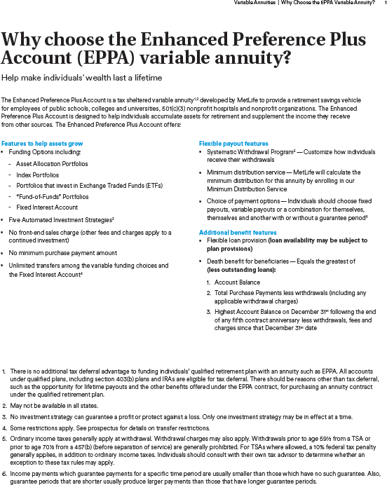
Investment Line-Up Review
The Enhanced Preference Plus Account (EPPA)
The Enhanced Preference Plus Account (EPPA) is a variable annuity designed to provide a retirement savings vehicle for employees of public schools, colleges and universities, not-for-profit hospitals and nonprofit organizations. The EPPA variable annuity may help participants accumulate assets for retirement as well as
provide a steady stream of income throughout their retirement years.
The options and features of this variable annuity include:
A variety of funding options, including Asset Allocation Portfolios, Index Portfolios, Portfolios that invest
in Exchange Traded Funds (ETF) and a Fixed Interest Account
Automated Investment Strategies such as Equity Generator, Equalizer SM, Rebalancer, Index Selector,
and Allocator SM
Free Transfers Among Funding Options
Systematic Withdrawal Program
Death Benefit
Benefit Sensitivity (waivers on withdrawal charges) EPPA Brochure
Refer to the product prospectus for additional information
When buying a variable annuity to fund a qualified retirement plan, clients should do so for the variable annuity’s features and benefits other than tax deferral. In such cases, tax deferral is not an additional benefit of the variable annuity. References throughout this material to tax advantages, such as tax deferral and tax-free transfers, are subject to this consideration.
16

Slide 17

Investment Line-Up Review
The Gold Track Select (GTS) in the State of NY
The Gold Track Select (GTS) variable annuity is a registered group variable annuity specifically designed for retirement savings. It is a long-term financial vehicle that may help with an overall retirement strategy. GTS variable annuity can help participants accumulate assets for retirement as well as provide a steady stream
of income throughout their retirement years.
The options and features of this variable annuity include:
A variety of funding options, including Asset Allocation Portfolios, Index Portfolios and a Registered Fixed Account Option (Funding options may vary based on the issuing insurance company and the contract issue date)
Automatic Rebalancing and Dollar-Cost Averaging Programs
Systematic Withdrawal Program
Death Benefit
Full Range of Annuitization Options
Benefit Responsive Waivers
Refer to the product prospectus for additional information
This product is no longer offered for sale to new plans, but new participants may be added to existing group contracts. No new plan or participant sales are permitted in NY.
17

Slide 18

Choosing Your Options
Gold Track Select and Registered Fixed Account Option in NY
Earns an interest rate guaranteed by the financial strength and claims-paying
ability of Metropolitan Life Insurance Company
For those who desire a competitive interest rate to meet his/her specific financial needs
No charge for transfers between GTS Registered Fixed Account and funding options
that are approved within your employer’s plan
No charge for withdrawals under the following circumstances:*
Normal Retirement Age
Severance from Employment
Disability
Hardship
Loans
Refer to the product prospectus for additional information
This product is no longer offered for sale to new plans, but new participants may be added to existing group contracts. No new plan or participant sales are permitted in NY.
The Gold Track Select (GTS) Registered Fixed Account Option is offered by prospectus only, which is available from your registered representative or through online enrollment at metlife.com/enrollnow. You should carefully consider the product’s features, risks, charges and expenses. This and other information is available in the prospectus, which you should read carefully before investing. Product availability and features may vary by state. Please refer to the contract prospectus for more complete details regarding the living and death benefits. The GTS Variable Annuity with Registered Fixed Account Option is issued by MetLife in the state of NY only.
*If permitted under the terms of your plan and subject to certain tax rules.
18

Slide 19

Choosing Your Options
GTS Fixed Account Transfer Restrictions in NY
Direct transfers are not allowed between the GTS Registered Fixed Account Option and a “Competing Fund”
A Competing Fund is any investment option comprising primarily fixed
income investment securities and/or money market instruments
Amounts previously transferred from the GTS Registered Fixed Account Option to the Underlying Funds may not be transferred back to the Fixed Account Option or a Competing Fund for a period of at least three months from the date of transfer
Amounts previously transferred from a Competing Fund to an Underlying
Fund (which is not a Competing Fund) may not be transferred to the
Fixed Account Option for a period of at least three months from the
date of the purchase payment
The Gold Track Select (GTS) Registered Fixed Account Option is offered by prospectus only, which is available from your registered representative or through online enrollment at metlife.com/enrollnow. You should carefully consider the product’s features, risks, charges and expenses. This and other information is available in the prospectus, which you should read carefully before investing. Product availability and features may vary by state. Please refer to the contract prospectus for more complete details regarding the living and death benefits. The GTS Variable Annuity with Registered Fixed Account Option is issued by MetLife in the state of NY only.
*If permitted under the terms of your plan and subject to certain tax rules.
19

Slide 20
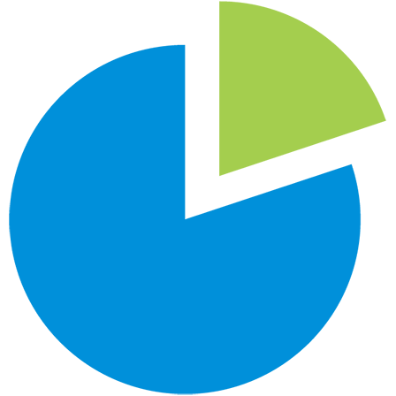
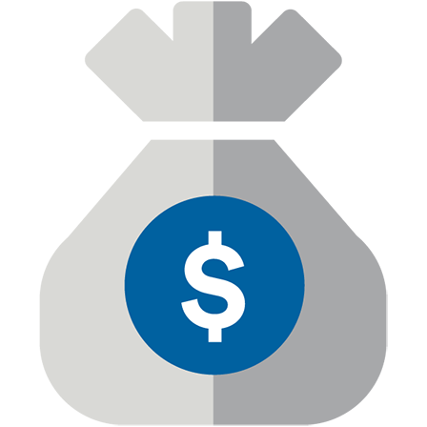


Understanding Your Retirement Plan
Eligibility
You are eligible to participate in your plan (effective immediately,
on a quarterly basis)
Contributions
The Internal Revenue Code (IRC) limits the amount you can contribute each calendar year. The IRC limit is $23,000 for 2024.
You may be able to make additional catch-up¹ contributions
[If your plan allows for Roth contributions other rules may apply to contributions and catch-up limits.] (include if permitted)
Rollovers
If you have an existing retirement plan account with a prior employer
or an IRA you may be able to roll over your previous retirement plan accounts into this plan
Employer Contributions
Employer may match up to (%) of eligible employee contributions
Additional contributions may be made by your employer regardless
of the contributions you make
Vesting
You will always have 100% ownership of the value in your
Plan account
You will always have full ownership of any rollovers you transfer to your Plan
Your employer contributions are vested according to the
[schedule below/immediately]
Withdrawals
Normal Retirement Age
Termination of Employment
Disability²
Death
Hardship²
In-Service Withdrawals²
[Loans] (include if permitted)
Loans are permitted. The amount you may borrow is limited
by rules under the IRC and your Plan.
If you are age 50 or over, the general limit contribution amount may be increased by an additional "catch-up" contribution. Additional catch-up contributions under a 403(b) plan may be available for employees who have
completed at least 15 years of service with certain eligible employers (e.g., schools, healthcare). 457(b) plans may offer additional catch-up contributions. Please reference www.irs.gov for more information.
Subject to IRC requirements.
20

Slide 21

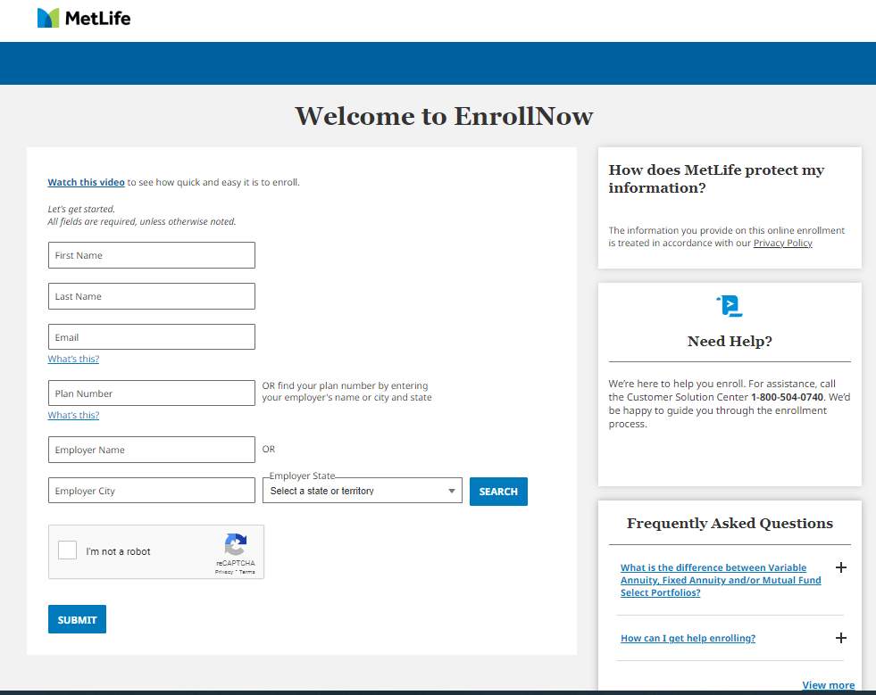
Enhanced Online Enrollment – EnrollNow
Get started today!
Visit metlife.com/retireready for resources
regarding EnrollNow
Watch our video at metlife.com/enrollnowvideo
21

Slide 22
Disclosures
This presentation should not be construed as tax or legal advice. Please consult your tax advisor or attorney for such guidance on how your employer-sponsored retirement plan can affect your taxes.
Distributions prior to retirement age are generally prohibited. Retirement savings program distributions are subject to your plan's restrictions and generally taxed as ordinary income tax in the year of distribution. Individuals should consult their tax advisor.
All product guarantees are subject to the financial strength and claims-paying ability of Metropolitan Life Insurance Company. Like most insurance contracts, MetLife contracts contain exclusions, limitations, reduction of benefits, surrender charges and terms for keeping them in force. Your representative can provide you with costs and complete details. This presentation is for informational purposes only and is not a substitute for professional advice. Neither Metropolitan Life Insurance Company nor any of its affiliates or their representatives are in the business of giving tax or legal advice. Individuals should consult with their own professional advisors to determine the appropriateness of any course of action, or strategy discussed for their situation. Metropolitan Life Insurance Company (MLIC), 200 Park Avenue, New York, NY 10166. Securities distributed through MetLife Investors Distribution Company (MLIDC) (member FINRA). Both are MetLife companies.
MetLife is not an ERISA investment fiduciary and is not providing investment advice to the plan, its fiduciaries or its participants, and does not exercise discretionary authority and control over plan assets.
Annuities are issued by Metropolitan Life Insurance Company, 200 Park Avenue, New York, NY 10166. MetLife Investors Distribution Company (Member FINRA) makes available participation in variable annuities, as well as participation in mutual fund options through its Mutual Fund Select Portfolios, for certain retirement plans. Both are MetLife companies. You may enroll in a variable annuity and participate in the Mutual Fund Select Portfolios though your retirement plan.
MetLife and/or its affiliates (“MetLife”) receive fees for providing administrative and recordkeeping services. The fees may be deducted directly from the Participant’s account, be paid for by the Employer, be paid from the Plan assets and/or paid from the fees deducted from Participant account values allocated to the mutual funds available under the Plan. The fees can vary based upon the mutual funds that are available in the Plan and Plan Participants’ asset allocations. Because different mutual funds pay different rates of compensation and rates of mutual fund compensation are subject to change from time to time, compensation received by MetLife varies based on the rates of compensation in effect from time to time. MetLife may receive a finder’s fee from certain fund companies, which is additional compensation to MetLife. MetLife may also impose separate transactional fees for certain Participant elected transactions that will be charged directly to Plan Participants unless paid by the Employer or the Plan. MetLife may increase the annual administrative service fee charged to Participants’ accounts. MetLife may also pay a portion of the fees it collects to an entity that is designated as a directed trustee or directed custodian of the Plan; or to a third-party administrator, or third-party investment advisor. MetLife may receive payments for administrative services provided under the third-party investment advisory services. MetLife also receives compensation for administrative services on annuities that are issued by unaffiliated insurance companies. MetLife also receives fees with respect to annuities it issues, according to the terms of the annuity contracts and prospectuses, if applicable. If you would like more information on the compensation that MetLife receives, contact your Employer. MetLife may realize a profit from any of the fees described above.
© 2024 MetLife Services and Solutions LLC
MLR02092018V-8 L1024044516[exp1026][All States][DC]
22

