Slide 1
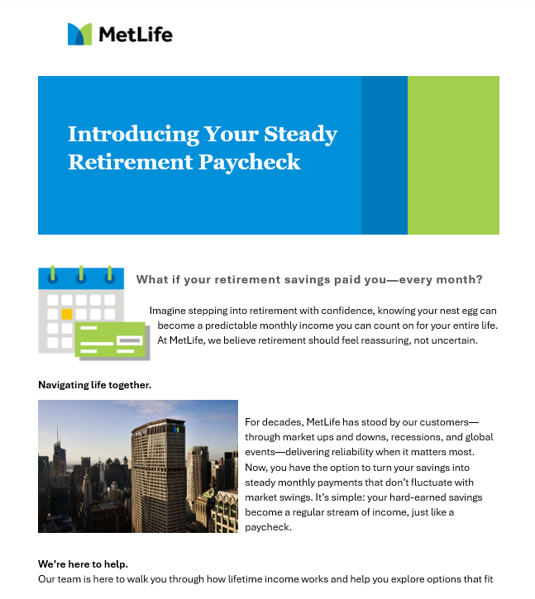
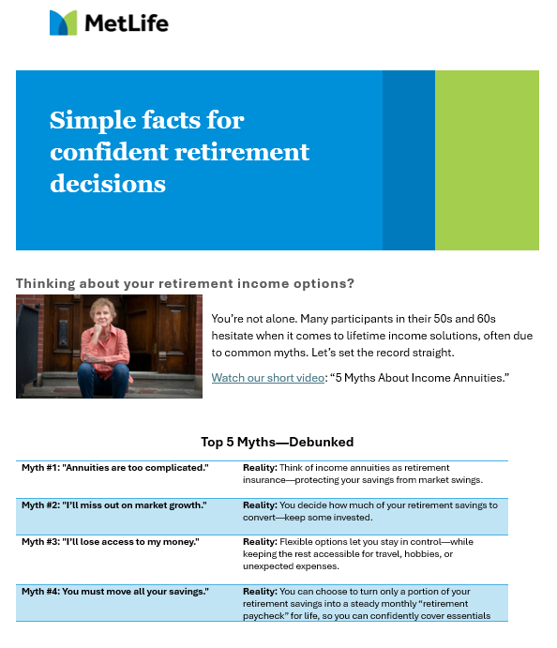




Retirement Paycheck Journey
Audience > Age: 55 to 75 years old > Seeking guaranteed income > Less than $250k in savings > Risk-averse
This email campaign reassures and educates plan participants in their mid-50s, 60s, and early 70s as they plan ahead for retirement. With a friendly, no-jargon approach, it explains how to turn part of your savings into a steady “retirement paycheck”—a personal pension for life.¹
Positioning Statement: “MetLife empowers you to turn a portion of your retirement annuity savings into guaranteed income payments—a personal pension designed to help you enjoy life with confidence. By choosing a secure stream of income that you can’t outlive, you and your loved ones can feel confident about the future, no matter how long retirement lasts.”
Emotional Reassurance
Myth-Busting Clarity
Lifetime Income Supplement
Partial Lifetime Income Story
Longevity Risk Awareness
Actionable Guidance
Retire from your job, not your paycheck
Busting 5 Myths About Annuities
Steady Income & Flexibility for Retirement
Make your retirement savings last
Picture Your Retirement Paycheck
How to get a steady retirement paycheck
Visit Retirement Paycheck Center
Access educational content, tools and resources for planning income in retirement.
© 2025 MetLife Services and Solutions, LLC MLR08112025 L4918772[exp1027][All States][DC]
¹ Please refer to your contract or prospectus for details on the income payment options available to you.
For Use With Financial Professionals and Plan Sponsors Only – Not For Distribution. For Informational Use Only.
Notes:
Our audience includes:
Individuals—regardless of gender or marital status—who are retired or nearing retirement (55-75) and haven’t yet annuitized. They originally chose an annuity through their workplace retirement plan as a way to save for retirement. Most were likely unaware of their distribution options, such as turning their savings into a steady income stream through annuitization, until they reached retirement.
Individuals seeking guaranteed income: Individuals who are primarily concerned with ensuring stable and reliable income throughout retirement. Predictable pension-like income stream —whether to support their lifestyle, cover specific expenses like living expenses, healthcare, or supplement what they already have.
Individuals with modest retirement savings: Research suggests that those with smaller nest eggs (e.g., less than $250,000 account value) may benefit most from annuitizing a larger portion of their savings.
Risk-averse customers: Annuitization offers stability and protection from market volatility, appealing to those who prioritize safety over aggressive growth.
Customers who aren’t interested in annuitizing or making withdrawals aren’t our focus. If their current products meet their needs and they don’t require additional income, we shouldn’t encourage them to make a change.

