Slide 1

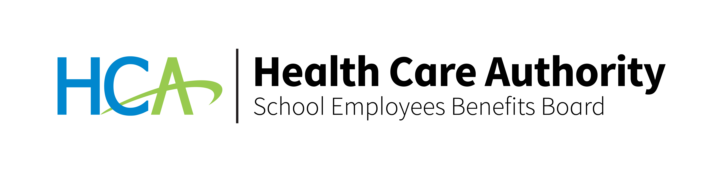
Vision Insurance
Notes:
Today I am going to provide a brief discussion on your Vision Insurance benefits offered by MetLife.

Slide 2
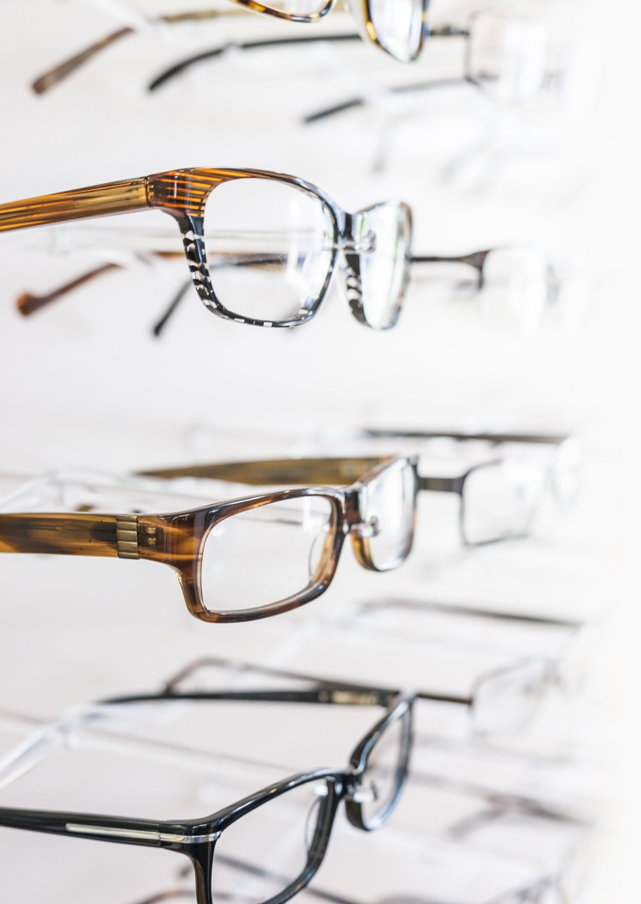
Why are vision benefits so important?
Caring for your eyesight is an important step to living healthier.
Regular visits to your eye care professional are important for your eyes. Through a routine exam, eye doctors can potentially spot serious health problems⁵, like diabetes, high blood pressure, and rheumatoid arthritis.
Savings that are easy to see for
you and your family¹.
Footnotes and disclosures appear at the end of this video
Notes:
Why is vision coverage important?
Just as our bodies require routine physicals, so do our eyes. Regular visits to an eye care professional may do more than just protect your eyesight — they can be very important to your overall health! Through a routine eye exam, eye doctors can potentially spot serious health problems, like diabetes, high blood pressure, and rheumatoid arthritis.
And cost doesn't have to be a barrier to maintaining your vision health. With this plan, the cost of getting a routine exam, a new set of glasses, contacts or even laser vision correction will be a lot less than you’d pay on your own. That can bring savings that are easy to see to families who want to maintain good vision at every stage of life!

Slide 3

MetLife Vision plan...savings, choice and convenience
Benefits for a wide range of covered services
  Ultraviolet (UV) coating
  Polycarbonate (shatter-resistant) lenses
  for children
  Fixed copays on popular lens options
Access to thousands of private-practice providers
and top optical chains like Costco⁶ Optical, Sam’s Club, Walmart, Visionworks, RX Optical and more…
Choice of eyewear from classic styles to the
latest designer frames
  Network private-practice providers offer
  over 200 options for eyewear
  Out-of-network coverage
  Visit metlife.com/wasebb-vision to find an in-network provider.
Notes:
The MetLife Vision plan was designed with you and your family in mind – you get eye care benefits for a wide range of covered services.
As a commitment to your overall vision care, the MetLife Vision plan provides benefits for ultraviolet protection, polycarbonate – or shatter resistant - lenses for children up to age 19 and fixed copays for popular lens options, like progressives, scratch-resistant and anti-reflective coatings to help you look and feel better.
With this plan, you can go to any licensed eye care professional. Or you can choose from any of the thousands of providers working out of private practices or at top optical retail chains, like Costco Optical, Rx Optical and more. To locate a network provider in your area, visit metlife.com/wasebb-vision , scroll down and click on “Find a Vision Provider”.
And, you get a broad selection of eyewear so you have greater opportunities to save while choosing eyewear that complements your personal style. MetLife’s participating providers have more than 200 options of eyewear to choose from.

Slide 4


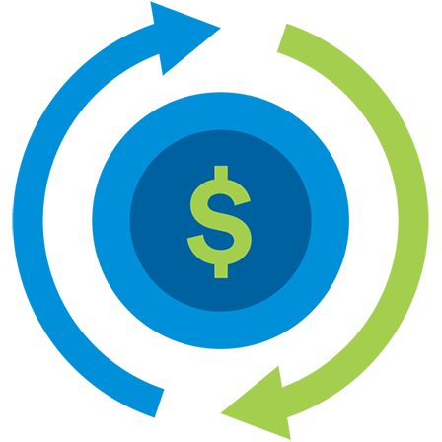

SEBB MetLife vision benefits
Benefit Type (Adult) | In-Network Member Pays | Out-of-Network Reimbursement⁴ | Benefits Renew
Eye Examination Comprehensive exam of visual functions and prescriptive corrective eyewear | Covered with no copay | Covered up to $45 allowance | Once every calendar Year
Standard Corrective Lenses Single vision Lined bifocal Lined trifocal Lenticular | Covered with no copay | Covered up to: $30 allowance (single vision) $50 allowance (lined bifocal) $65 allowance (lined trifocal) $100 allowance (lenticular) | January 1 of odd Calendar Years
Notes:
Now, let’s talk specifics. Let’s look at MetLife’s plan design for your vision coverage. This simple chart gives you the facts and shows how you receive benefits whether you visit a in or out-of-network vision provider for services.
Whether or not you decide to visit a network provider, your employer has designed a plan that provides a level of coverage for routine eye exams. This way, your coverage benefits every member of your family – even those who don’t wear glasses or contacts at all.
As you can see, there is no copay for in-network services including exams and eyewear. When you visit an out-of-network provider, you are responsible for any copay amounts and a portion of the costs for these services. You will typically pay for the full cost of the treatment at the time of service, then submit a claim form for reimbursement from MetLife.

Slide 5
Benefit Type (Adult) | In-Network Member Pays | Out-of-Network Reimbursement⁴ | Benefits Renew
Standard Lens Options² Ultraviolet coating | Covered with no copay | Applied to the allowance for the applicable standard lenses ($30-$100) | January 1 of odd Calendar Years
Progressive | Standard: $0 Premium: $95-$105 Custom: $150-$175 | Covered up to $50 allowance | January 1 of odd Calendar Years
Polycarbonate Scratch-resistant coating Anti-reflective coating Photochromic | $35 $17-$33 $41-$85 $75 | Applied to the allowance for the applicable standard lenses ($30-$100) | January 1 of odd Calendar Years
Frame Allowance Private-practice provider 20% off the additional amount when patients choose a frame that exceeds the allowance. Costco, Walmart, and Sam’s Club | $0 (for frames that cost up to $200), then member pays 80% of balance over $200 $0 (for frames that cost up to $110), then member pays 100% of the remaining balance | Covered up to $70 allowance | January 1 of odd Calendar Years
Notes:
Now let’s look at the other options covered by your plan. Lens options can improve the appearance, durability, and/or function of your glasses. For example:
Ultraviolet coating. This is a treatment that is applied to lenses to filter out harmful rays of the sun. It is recommended that glasses block 100% of both UVA and UVB rays to minimize eye damage from the sun’s rays.
Polycarbonate lenses. A lens material that is thinner, lighter, and more impact-resistant than standard plastic. Please note Polycarbonate lenses are the standard for children’s eyewear with no co-pay and are considered elective coverage for adults.
Progressive lenses. These lenses can be either bi-focal or multi-focal lenses with no visible lines where the lens power gradually changes from distance to near.
Scratch-resistant coating. This is a film or coating that protects lenses from scratching.
Anti-reflective coating. This is a lens treatment for your glasses that helps to reduce distracting glare and eye fatigue by reducing the amount of light reflecting off the lens surface and making the lenses appear clearer. Your eyes will also be more visible behind the lenses.
Photochromic. This refers to lenses that automatically change from clear to dark in the presence of ultraviolet (UV) radiation.
Your coverage also includes a frame allowance of up to $200 when you see an in-network provider. Your frame allowance is up to $70 at out-of-network providers, and $110 at Costco, Walmart, or Sam’s Club.
Additionally, when you visit an in-network private-practice provider and the frames you choose exceed the benefit allowance, you get a 20% discount off the amount that exceeds your allowance.
All lens options are available at participating private practice provider offices. Please check with your provider for details and copays applicable to your lens choice. Please contact your local Costco to confirm the availability of lens options and pricing prior to receiving services. Additional discounts may not be available in certain states.

Slide 6
Benefit Type (Adult) | In-Network Member Pays | Out-of-Network Reimbursement⁴ | Benefits Renew
Contact Lenses (instead of glasses) Conventional and disposable | $0 (for lenses that cost up to $200); then member pays 100% of balance over $200 | Covered up to $105 allowance | January 1 of odd Calendar Years
Medically Necessary | Covered with no copay | Covered up to $210 allowance | January 1 of odd Calendar Years
Additional lens enhancements² Additional discounts on glasses and sunglasses Laser vision correction³ | Average 20-25% savings on all other lens enhancements 20% discount off the cost for additional pairs of prescription glasses and non-prescription sunglasses, including lens options. Discounts averaging 15% off the regular price or 5% off a promotional offer for laser surgery including PRK, LASIK, and Custom LASIK. Discounts only available from MetLife participating facilities.
Notes:
Your plan also includes coverage for contact lenses – including a discount for the initial fitting and evaluation. A lens fitting will help to find the most appropriate contact lens for your optimal comfort and vision.
You’ll receive a coverage allowance of up to $200. Out-of-network charges will be higher.
In addition, the plan includes a discount for additional pairs of prescription glasses and non-prescription sunglasses so that every member of your family can benefit.
You’ll even be eligible for discounts averaging 15-20% off the regular price of laser surgery including PRK, LASIK, and Custom LASIK. However, these discounts are only available from MetLife participating facilities.

Slide 7


It’s easy to enroll
To learn more about MetLife vision coverage, please visit: metlife.com/wasebb-vision
MetLife Customer Service
1-833-854-9624
Monday through Friday, 5 a.m. – 8 p.m. PT
To enroll, please visit Benefits 24/7:
benefits247.hca.wa.gov
Notes:
To learn more visit metlife.com/wasebb-vision
If you have questions or need help, call 1-833-854-9624. A customer service representative will be happy to help you. To enroll or make changes to your vision benefits, please visit Benfits247.hca.wa.gov. Thank you.

Slide 8
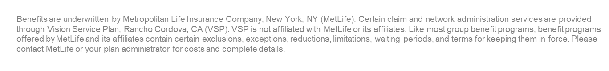
Footnotes and disclosures
Your actual savings from enrolling in the MetLife Vision Plan will depend on various factors, including plan premiums, number of visits to an eye care professional by your family per year and the cost of services and materials received. Be sure to review the Schedule of Benefits for your plan's specific benefits and other important details.
All lens enhancements are available at participating private practices. Maximum copays and pricing are subject to change without notice. Please check with your provider for details and copays applicable to your lens choice. Please contact your local Costco to confirm the availability of lens enhancements and pricing prior to receiving services. Additional discounts may not be available in certain states.
Custom LASIK coverage only available using wavefront technology with the microkeratome surgical device. Other LASIK procedures may be performed at an additional cost to the member. Additional savings on laser vision care is only available at participating locations.
You may receive services from an out-of-network provider, even though you may receive greater value for your benefit dollars if you select a provider who participates in the network. If you choose an out-of-network provider, you must pay the provider for all charges and then submit a claim for reimbursement to: MetLife Vision, PO Box 495918, Cincinnati, OH 45249-5918..
Versant Health. (2025). In plain sight: Examining America’s eye health challenge and how to solve it (4th Annual Vision Wellness Study). https://versanthealth.com/wp-content/uploads/2025/06/Versant-Health-Vision-Wellness-Study-Fourth-Annual-Core-Report.pdf
All lens options are available at participating private practice provider offices, and maximum copays and pricing are subject to change without notice. Please check with your provider for details and copays applicable to your lens choice. Please contact your local Costco to confirm the availability of lens options and pricing prior to receiving services. Additional discounts may not be available in certain states.

Slide 9
Thank you.
Metropolitan Life Insurance Company| 200 Park Avenue | New York, New York
L4704421[exp0827][All States and][All Territories]
Notes:
Thank you for taking time to listen to this brief presentation about your MetLife Vision Insurance.

