Slide 1
Project Kick-off Templates
Insert Date Here

Slide 2
Use the templates here to kick start your “Project Kick-off” deck.

Slide 3
Process Timing Template

Slide 4
This revamp effort will be completed across five main phases of work
Resource and plan for experience design sufficiently
Uncover real customer needs and solutions
Prototype and create the experience across the whole journey
Build, test, and learn with agility
Continuously improve to align with customer needs
Click here for more detailed view of revamp process

Slide 5
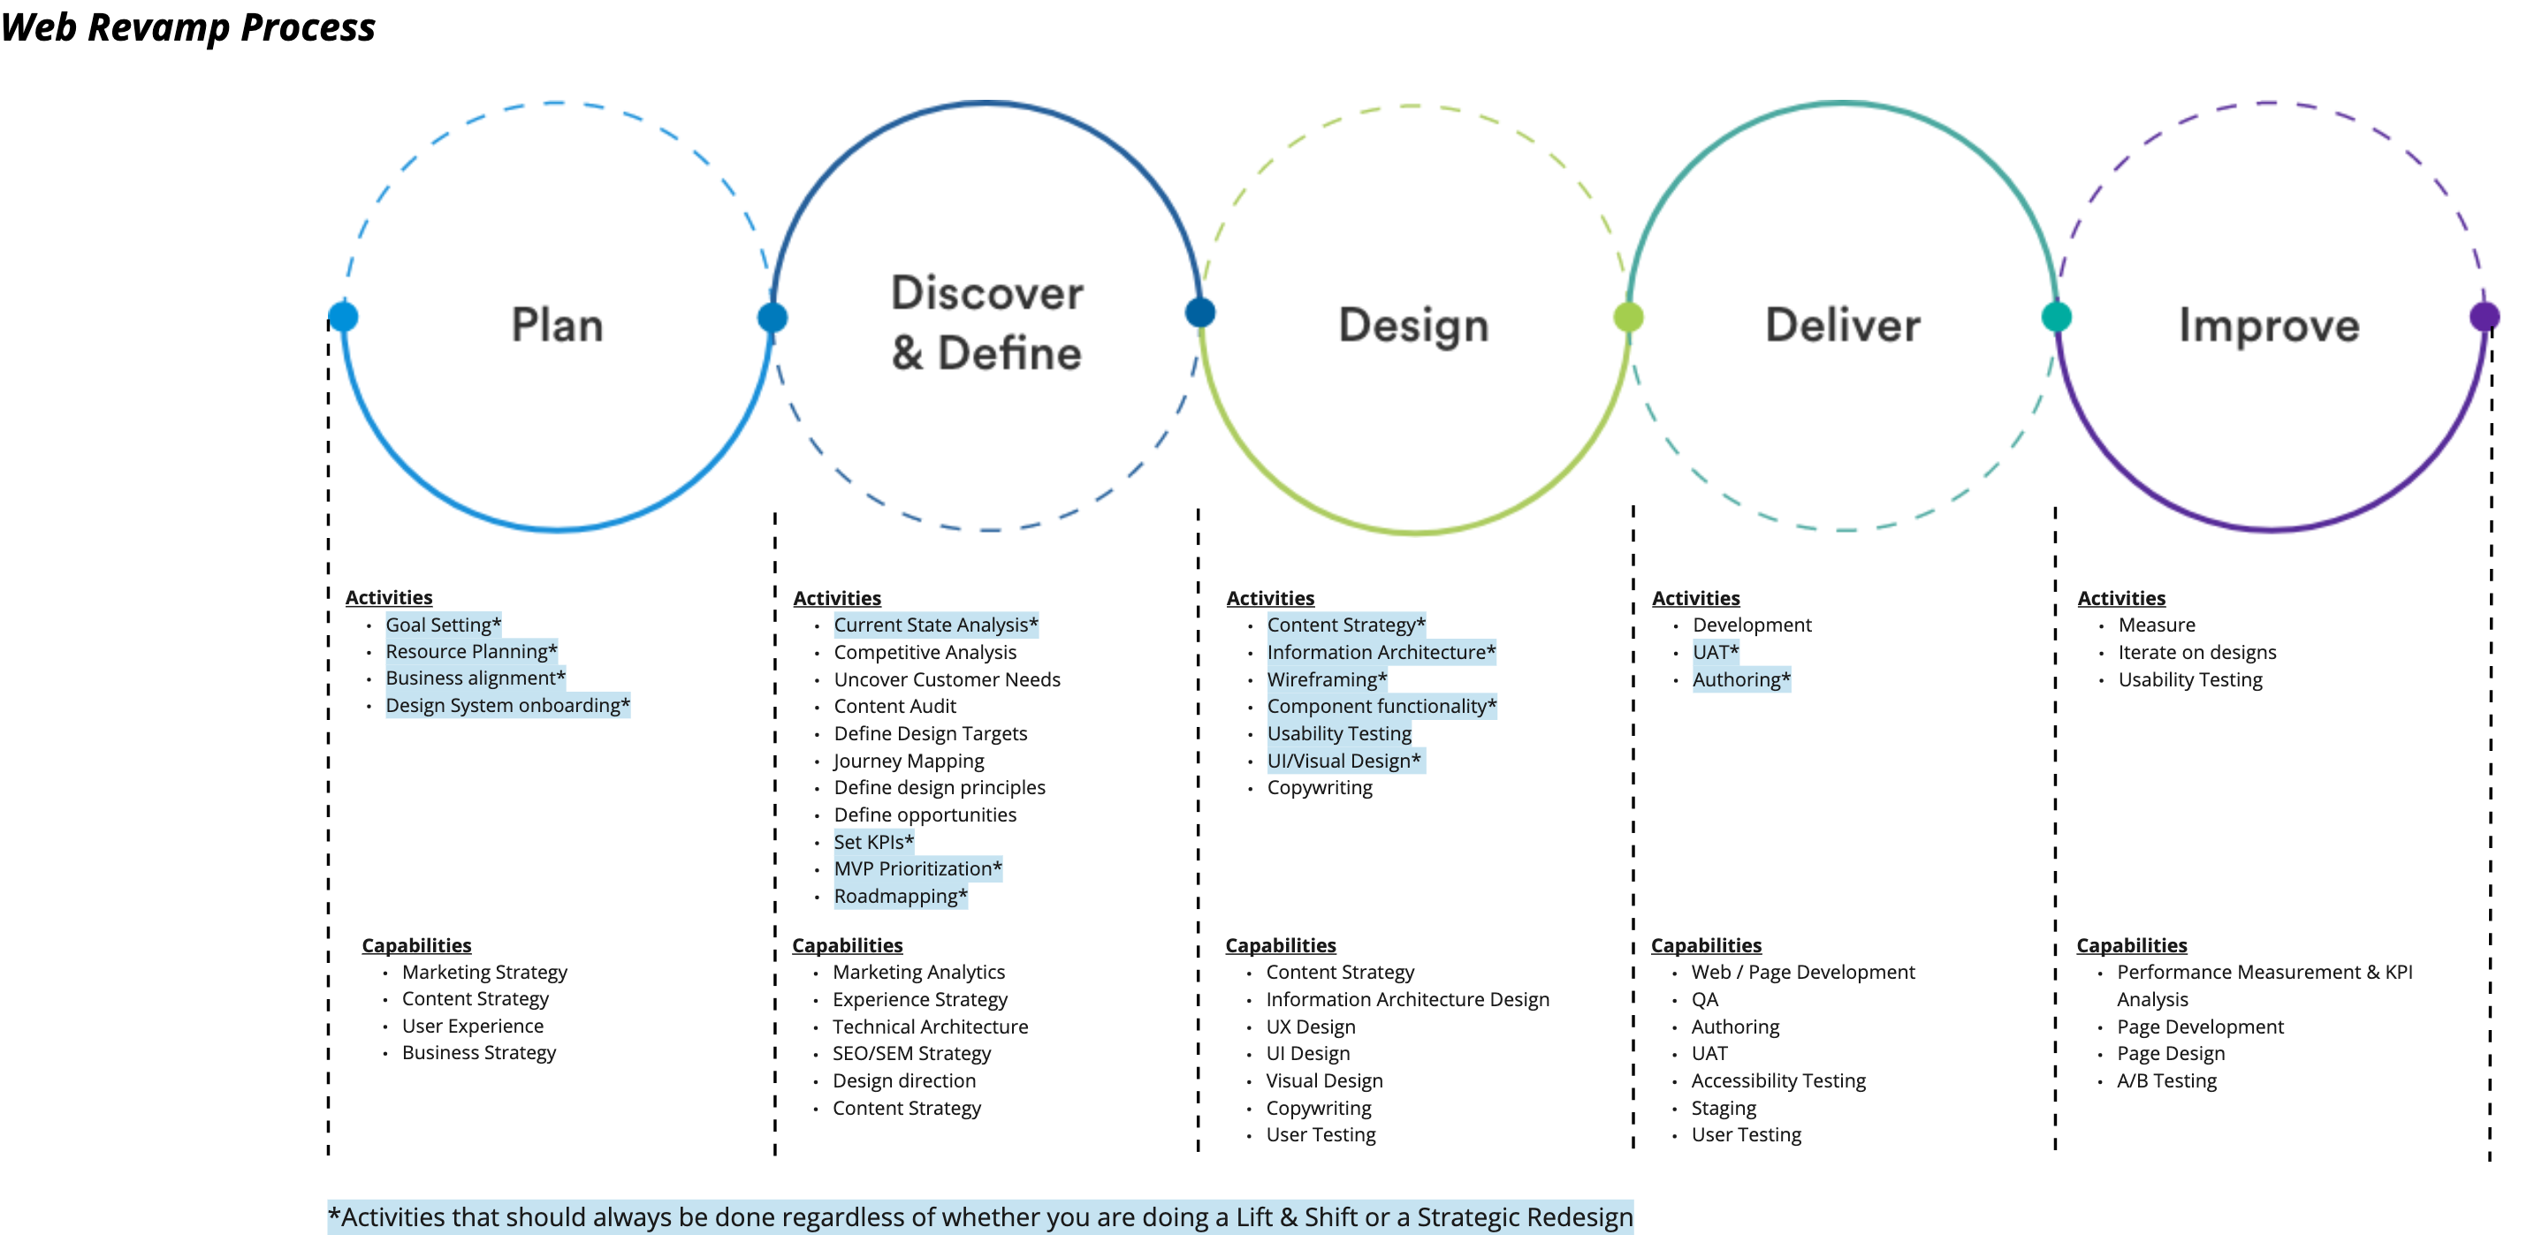
Process Overview with Activities & Capabilities by Phase
Click here for more detailed view of revamp process

Slide 6
This work is expected to run X weeks
EXAMPLE-LOCAL TEAM TO FILL OUT
WEEK | 1 | 2 | 3 | 4 | 5 | 6 | 7 | 8 | 9 | 10
PLAN
Project kick-off
Activity 1
Activity 2
Activity 3
DISCOVER/DEFINE
Activity 1
Activity 2
Activity 3
DESIGN
Activity 1
Activity 2
DELIVER
Activity 1
Activity 2
Activity 3
IMPROVE
Activity 1
Activity 2
When planning out work consider…
Allowing ample time for revisions between activities
Building in flexibility should certain phases/activities take longer than expected
Adding in dedicated activities early on around Quality Assurance and ADA checks to ensure content and designs are up to the standards of MetLife

Slide 7
Roles, Responsibilities and Capabilities Template

Slide 8
MetLife Project Team
LOCAL TEAM TO FILL OUT
Project Sponsor
Name(s)
Steering Comm. Members
Name(s)
Revamp Lead/PM: Name
Website Owner: Name
Project Cross Function Working Team: name, name, name
Local Team:
Regional Team (if applicable):
Global Team :
Jon Doe (Revamp Team Lead)
Jane Day (Strategist)
Name (Role)
Name (Role)
Kara Green (Role)
Tom Wabash (Role)
Name (Role)
Name (Role)
Cynthia, Ko-Baek (Role)
Roxanne Knapp (Role)
Name (Role)
Name (Role)

Slide 9
Capabilities Needed By Phase
LOCAL TEAM TO FILL OUT
Local teams will be owning all final decisions relating to their specific website work. This chart can help clarify what capabilities stakeholders might need use during different phases of work.
PHASE | Plan | Discover/ Define | Design | Deliver | Improve
Example Capabilities Needed Overall | Marketing Strategy Content Strategy User Experience Business Strategy | Marketing Analytics User Research Experience Strategy Technical Architecture SEO/SEM Strategy Design Direction Content Strategy | Content Strategy Information Architecture Design UX Design UI Design Visual Design Copywriting User Testing | Web / Page Development QA UAT Accessibility Testing Staging Authoring User Testing | Performance Measurement and KPI Analysis Page Development Page Design A/B Testing
Note: Illustrative content in italics, local team to fill out based on revamp effort and resources available

Slide 10
Accountability and Capabilities
LOCAL TEAM TO FILL OUT
 | Local Team | Regional Team | Global Team | Agency Partner
Accountable for… | Owns all final decisions relating to local market website work Provides day to day guidance and structure Point of contact with the agency | Provides assistance and scale where necessary Role varies with size of local team and need | Provides input on best practices for website revamp work Provides guidance on appropriate use of design system Provides support onboarding into the design system Team - reviews all new component development Platform / Tech Team: Enable code base – components and templates (if not enabled already) Enable/ provide advisory support new Header and Footer implementation across old pages Enable or provide advisory support for migration of old experience to new experience Advisory on platform related questions | Executes on strategy and vision set by local team
Names/Capability | Name, Capability Name, Capability Name, Capability | Name, Capability Name, Capability Name, Capability | Name, SME in… Name, SME in… Name, SME in… | Name, Capability Name, Capability Name, Capability
.
Note: Illustrative content in italics, local team to fill out based on revamp effort and resources available

Slide 11
Revamp Objectives Template

Slide 12
Project Background and Overview
LOCAL TEAM TO UPDATE
Building Block
Questions and Tips to Consider
The Vision | What is our overarching vision for our future-state website? Be ambitious with this statement, as it will provide a “north star” for your teams to work towards in the future E.g., Website earns trust by providing clear, relevant and simple information about MetLife via best-in-class experiences that differentiates MetLife in the market
The Goal | What should we be aiming for our website to do in an ideal state? Try to be as specific as possible here. What are the qualities of the experience you want to deliver? E.g., Identify and align website to bring the MetLife brand and purpose to life, clearly inform users of our solutions, and guide them to the right purchases
The Role | What role will our website compared to our other channels? Consider how users will interact with the website in comparison to other channels e.g., app, customer service etc. E.g., Website is the primary channel for lead conversion and integrate with other digital touch points via mobile chat and human-driven sales events
Expected Outcome(s) | What are the outcomes we’re aiming to achieve with this revamp work for MetLife and our customers? Think about including measures that will indicate success against our goals E.g., Improved NPS scores for trust and reliability, increased time on site, increased lead conversion, lower costs and time spent maintaining site

Slide 13
Ways of Working: Tools and Tech Template

Slide 14
Ways of Working: Process Tools/Tech
Fill out the following table and distribute to teams to clarify the different tools and technology stakeholders will be using throughout the process
Use Case | Example Tool/Tech | Local Team Tool/Tech
Video Conferencing | Webex
Virtual Collaboration/ Brainstorming | Miro
File Storage | Sharepoint
Daily Team Communication | Webex Group Chat or Email
CXD Communication | Email
UX/UI Design | Adobe Creative Suite
Design Hand-off to Developers and Authors | Zeplin or Adobe Creative Suite

Slide 15
Risk Assessment Template

Slide 16
What are the risks we must consider in this work?
LOCAL TEAM TO FILL OUT
For Discussion
Where are the biggest risks with this work? | What is the likelihood of this risk occurring on a scale from 1-5? (5 being most likely) | What happens if those risks become realized? | How big is the impact if the risk is realized on a scale from 1-5? (5 being most impactful) | How might we mitigate those risks now?
Launch is delayed due to scheduled code freeze | 3 | Initial launch will be delayed | 3 | Loop in platform team early on in process to sync with their release calendar
XXX | XXX | XXX | XXX | XXX
XXX | XXX | XXX | XXX | XXX
XXX | XXX | XXX | XXX | XXX
XXX | XXX | XXX | XXX | XXX
Note: Illustrative content, local team to fill out independently

Slide 17
Work Done To Date Template

Slide 18
What work has been done to this point?
LOCAL TEAM TO UPDATE AND FILL OUT
WIP
PHASE OF WORK | KEY ACTIVITIES COMPLETED | FILE NAME (LINK) | KEY SUMMARY OF DOCUMENT | DATE | OWNERS
Plan* | Identified objectives, overall vision and key areas of opportunity for revamp Identified KPI’s and business objectives of this work | Pre-project brief (linked) | Overview of revamp efforts with detail on timing, stakeholders, goals and success metrics | 9/10/2021 | Stanley C.(MetLife) Michael Scott (MetLife)
Discover & Define | Developed key personas Developed persona website needs and objectives | Persona deliverable | Detail on target personas for revamp efforts—includes information on needs, wants and demographics |  | Hanif Perry (Prophet)
 |  | Need mapping deliverable |  |  | Hanif Perry (Prophet)
XXX | XXX XXX | XXXX | XXX | XXX | XXX
Note: Illustrative content in italics, local team to fill out independently

Slide 19
Work To Be Done

Slide 20
What work is this team responsible for? (1/2)
LOCAL TEAM TO UPDATE AND FILL OUT
PHASE OF WORK | KEY ACTIVITIES TO COMPLETE | KEY OUTPUTS | EXAMPLES | DEADLINE(S) *To be filled out with agency input
Define | Identify objectives, overall vision and key areas of opportunity for revamp | Vision Statement Priority Opportunity areas for revamp Project Objectives | LINK | 9/13
Note: Illustrative content in italics, local team to fill out independently

Slide 21
What work is this team responsible for? (2/2)
LOCAL TEAM TO UPDATE AND FILL OUT
PHASE OF WORK | KEY ACTIVITIES TO COMPLETE | AGENCY OWNERS | METLIFE DAY TO DAY PARTNER | METLIFE STAKEHOLDERS
Define | Identify objectives, overall vision and key areas of opportunity for revamp | Prophet | Roxanne K. | Cynthia K. Caroline M.
Note: Illustrative content in italics, local team to fill out independently

